Slide 1
LANGUAGES
BY:- Ayush G | Pratik A | Prudhvivenkat P | Tauseef A

Slide 2
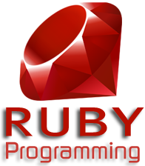
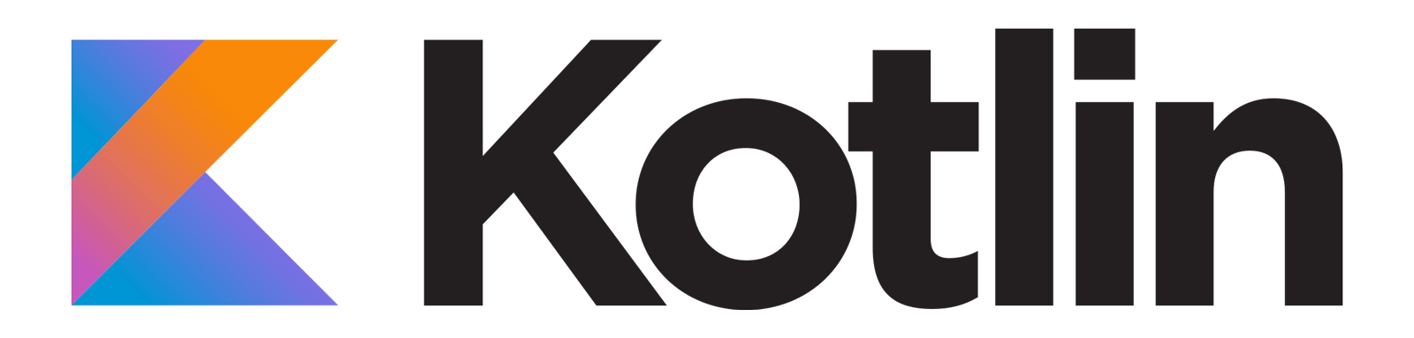


List of Languages

Slide 3
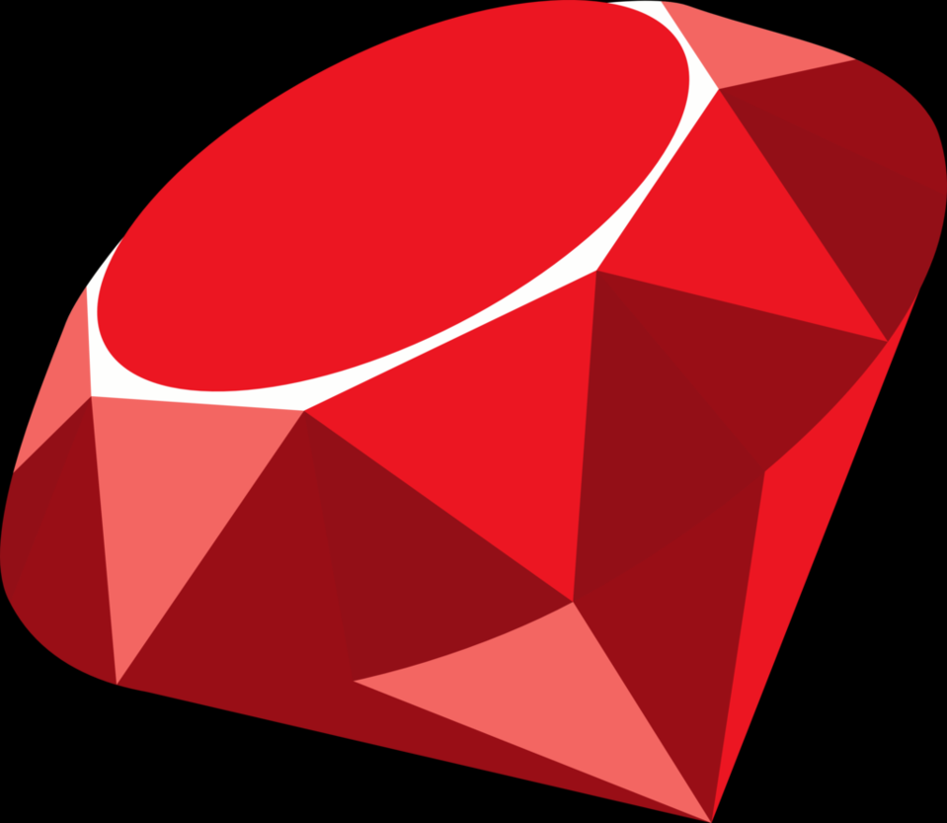
Reason for Choosing Ruby
Ruby is a dynamic, open source programming language with a focus on simplicity and productivity. It has an elegant syntax that is natural to read and easy to write.
Ruby is counted as one of the leading programming languages of the world. It is a combination of several programming languages like Perl, Ada, Eiffel and Lisp.
It supports multiple programming paradigms.
It is object oriented as well as a functional programming language
One of the main reasons for choosing this language was its dynamic nature and the option to compile ruby code to iOS or flash.

Slide 4
Hello World Program
#The Greeter class
class Greeter
def initialize(name)
@name = name.capitalize
end
def salute
puts "Hello #{@name}!"
end
end
# Create a new object
g = Greeter.new("world")
# Output "Hello World!"
g.salute

Slide 5
Some Projects:
Gosu:
It is a 2D game development library for Ruby and C++.
Gosu is focused, lightweight and has few dependencies (mostly SDL 2). It provides:
a window and a main loop
2D graphics and text, powered by OpenGL or OpenGL ES
sounds and music
keyboard, mouse, and gamepad input
SQLite3/Ruby Interface
This module allows Ruby programs to interface with the SQLite3 database engine. You must have the SQLite engine installed in order to build this module.

Slide 6
Kotlin is 100% interoperable with Java. You can literally continue work on your old Java projects using Kotlin. All your favourite Java frameworks are still available.
Kotlin is a fully supported programming language on Android.
Android Studio has official support for Kotlin, starting from Android Studio 3.
Kotlin is not so verbose and it is readable than java.
Some of the problems in java are addressed in kotlin.
One of the obvious applications of Kotlin is Android development.
Kotlin was announced as an official Android development language at Google I/O 2017.

Slide 7
The First Program – Hello World
package hello
fun main(args : Array<String>) {
println("Hello, world!")
}

Slide 8
Some Projects:
App development
server-side development
web development

Slide 9
Scala is a modern multi-paradigm programming language designed to express common programming patterns in a concise, elegant, and type-safe way. It smoothly integrates features of object-oriented and functional languages.
Hello World Example:
object HelloScala{
def main(args: Array[String]): Unit = {
System.out.printIn(“Hello World”);
}
}
Many MNCs like Twitter, Apple Inc., Netflix etc. use Scala and its demand has been increasing rapidly.
We chose Scala because of its growing popularity and it very concise and elegant as compared to Java which makes coding in Scala simpler. Also it can used for a lot of things, ranging from machine learning to web apps to android development.

Slide 10
Few Projects on GitHub:
Scrypto:
It is an open source cryptographic toolkit designed to make it easier and safer for developers to use cryptography in their applications. It was extracted from Scorex, open-source modular blockchain & cryptocurrency framework.
Android Projects using SBT:
This is an easy-to-use plugin for existing and newly created android projects. The plugin supports all android projects configurations. 3rd party libraries can be included by placing them in libs, or they can be added by using SBT's library Dependencies feature.
Macroid:
It is a modular functional user interface creation language for Android, implemented with Scala macros. Striving to be focused on one thing (GUI), Macroid promotes composability and high-level abstractions.
Scaloid:
It is a library that simplifies your Android code. It makes your code easy to understand and maintain by leveraging Scala language. Hence, it is also referred to as simpler android.

Slide 11

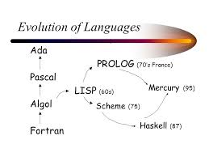
Why Mercury??
Mercury is a purely declarative logic/functional programming language. It is aimed at programming in the large.
Mercury technologies: • declarative debugging• automatic parallelization.
The purity of Mercury is key in making both of these feasible.
Mercury supports higher-order programming, with closures, currying, and lambda expressions.
The Mercury compiler is written in Mercury itself

Slide 12
Some basic syntax:
fibs/2 is the hello world of declarative programming. F is the Nth Fibonacci number.
fibs(N, F) :-
( N < 2 -> F = 1 ;
fibs(N - 1, FA),
fibs(N - 2, FB),
F = FA + FB ).
Predicates do not have return values per-se. They are either true or false for a given set of arguments. Arguments may be either input or output.

Slide 13
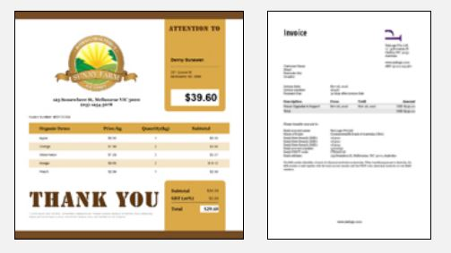
PRINCE
Convert your HTML documents to PDF. Beautiful printing with simple CSS.
Prince, it is quick and easy to create PDF files that can be printed, archived, or downloaded.
Prince is often used to generate PDF invoices from HTML pages; customers first see the invoice on their screen, and then receive a printable PDF version of the invoice.

Slide 14

Popular Projects on GitHub..
tejonbiker / Earhart
This project involves several things related to the development of a hexacopter controller, the Raspberry Pi is the first platform to implement the controller,
ikuwow / inpainting_criminisi2004
MATLAB Implementation of inpainting Algorithm
DuncanMC / iOS-CAAnimation-group-demo
This is a demo project that illustrates various Core Animation techniques, focusing on animation sequences created using CAAnimationGroup

Slide 15
THANK YOU

